Slide 1
BPDA | Brazilian Community Census Analysis
Early Insights Presentations

Slide 2
Brazilian Community Census Analysis
Team member: Zhihao Gu, Chenyang zhang, Minghui Yang, Xiaohan Zou, Pengchao Yuan.
Sponsored by Boston Planning & Development Agency (BPDA)
Project goal
Create visualizations using cleaned and processed data.
Identify trends in community demographics (throughout the US).
Background for project
No background needed

Slide 3
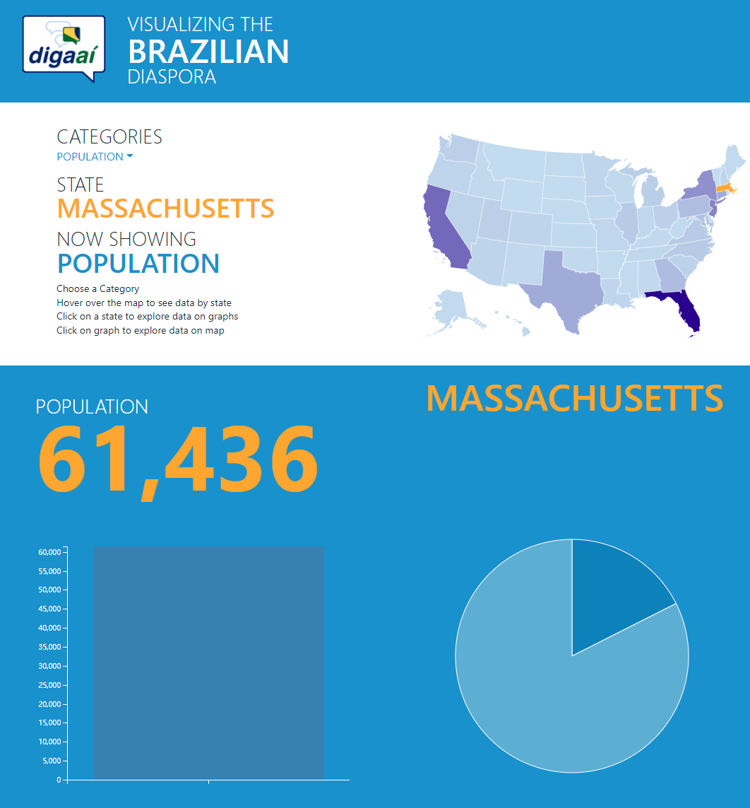
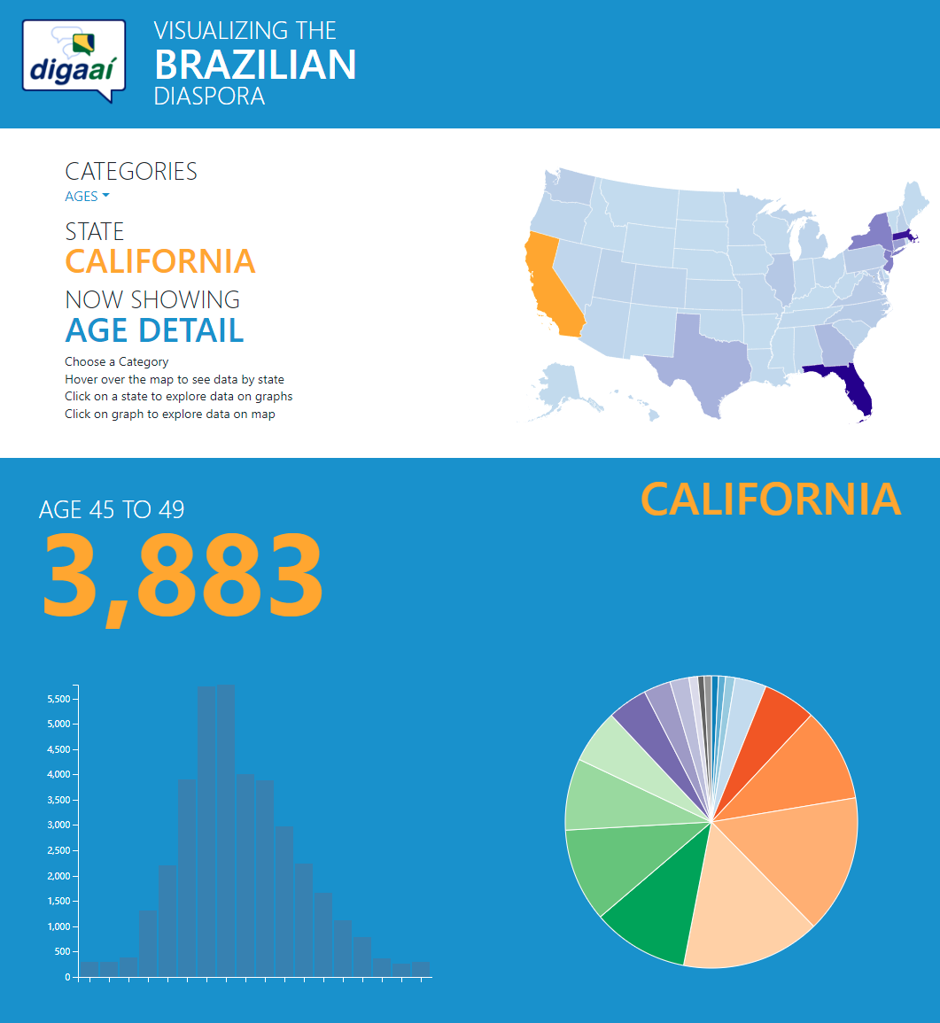
Previous work about Brazilian Community
https://digaai.herokuapp.com/
Notes:
They already have a website to show the data
Not interactive enough
No comparison
Want: a more interactive way to show data, also find some patterns/trend

Slide 4
Data
Data are provided
Preprocessed Brazilian Immigrants data
Population
Age distribute
Gender
Marital status
Citizenship
Education
Employment
Income
Both per year and per State
Notes:
Data are already provided in csv, including year and state population information, all kinds of
Problem: some data missing, missing index

Slide 5
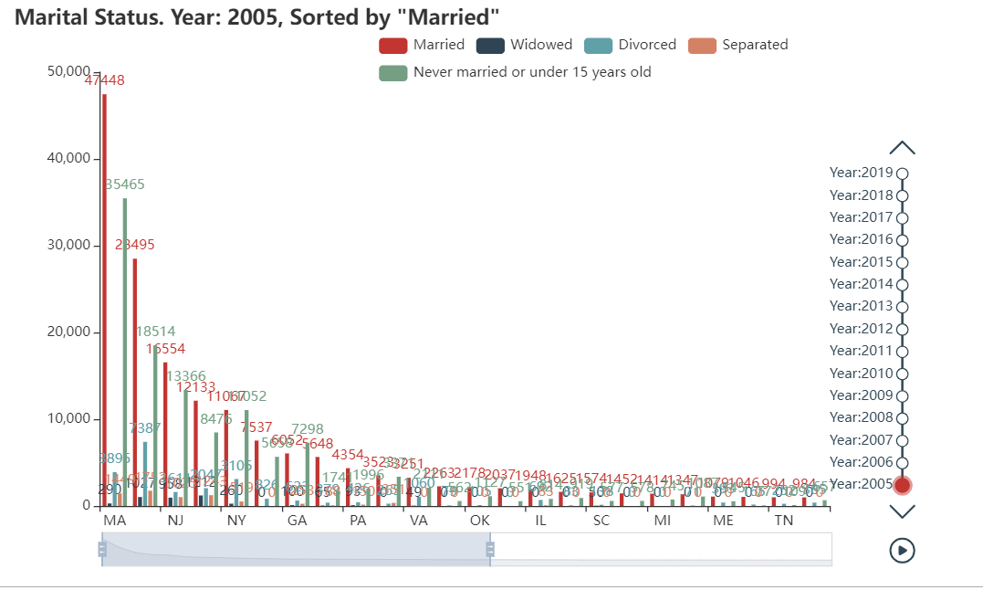
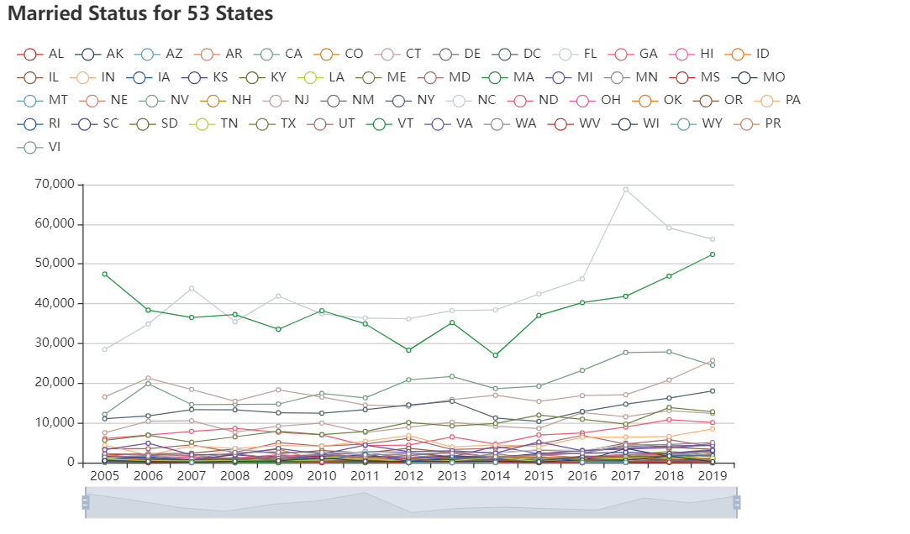
Current progress – dynamic visualization
Visualization by state
Visualization by year
Powered by pyecharts, an opensource javascript visualization library
Notes:
Solution: use pyecharts, easy to embed, including timeline, interactive, select what to display
Compare data between years
Compare data between states
Meets the clients requirements perfectly

Slide 6
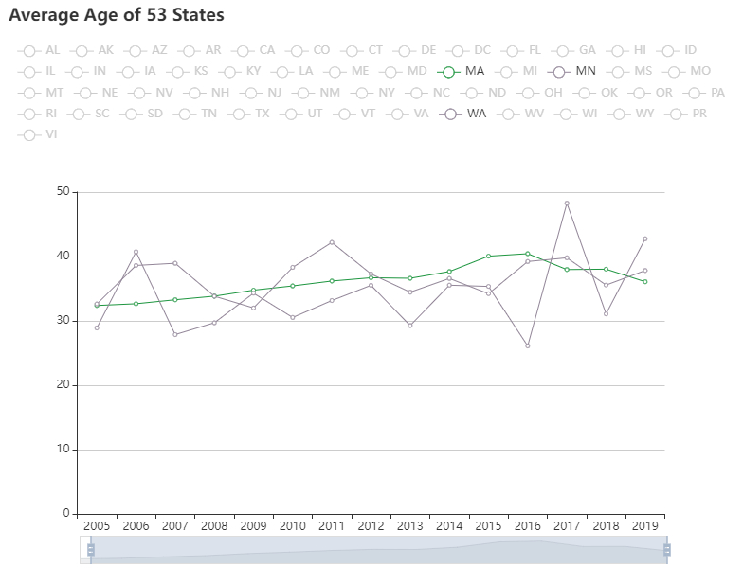
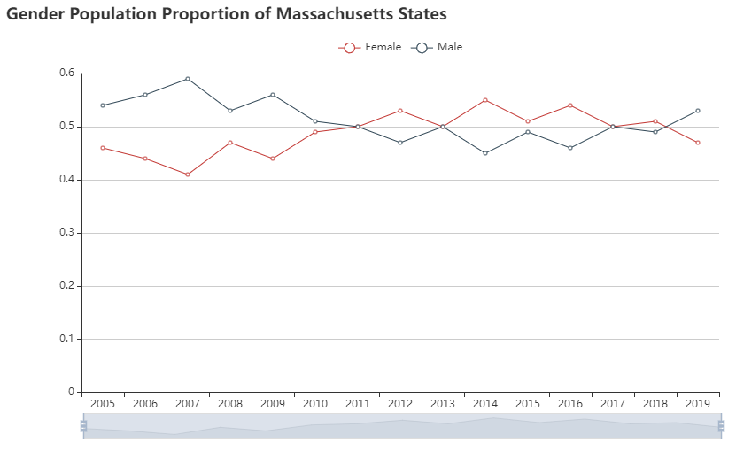
Next Step
Analyze the trends or patterns in the data
focus on
Population
Gender
Age
Income
Notes:
To analyze the pattern
How it changes
Average age, age distribution, gender distribution.
If people move from one states to another, geographic related?

Slide 7
Challenge & Limitation
Challenges
Visualization should allow the user to set date parameters.
Visualization including timeline.
The chart can be embedded into website.
Sort the data in descending order, show top 10 states.
Some patterns of demographics data are hard to predict.
Limitation
Data must be pre-sort by code.
Too many features in the data, hard to decide which to plot and analyze.

Slide 8
Divide labor:
Plot by year: Zhihao Gu, Pengchao Yuan
Plot by states: Minghui yang, Xiaohan Zou
Data process: Chenyang Zhang

